Slide 1

IBM Project Presentation
on
“Proactive Equipment Care using Analytics with Cloud - Cloud Integrated Analytics”
By
Group ID: G03
Team Members Name & Enrollment No:
Patel Megh(22162121011)
Prajapati Pratham(22162171023)
Patel Tirth(22162101016)
Under The guidance of
Prof. Umesh Lakhtariya /Mr. Anoj Dixit
Institute Of Computer Technology, Ganpat University
Date:- 21th February 2026

Slide 2
Index Of Content
Abstract
Problem Statement
Objectives
Scope of the Project
System Architecture
Workflow of Project
Technology Stack
Module Description
Advantages
Limitations

Slide 3
Abstract
Proactive Equipment Care using Analytics with Cloud is a cloud-based intelligent maintenance system designed to predict equipment failures before they occur.
Traditional maintenance approaches are reactive, leading to unexpected downtime and high repair costs. This system integrates data analytics, machine learning, and cloud computing to monitor equipment health in real-time.
Motor data is processed and analyzed to detect patterns and anomalies.
The ML model predicts potential failures, enabling preventive maintenance.
The solution improves operational efficiency, reduces downtime, and enhances equipment lifespan.

Slide 4
Problem Statement
Industries rely heavily on reactive maintenance strategies, where equipment is repaired only after failure occurs. This leads to:
Unexpected equipment failures cause production loss, downtime, and high maintenance costs in many industries.
Traditional maintenance happens after equipment fails. This causes production loss,repair cost,and safety risk.
A smart system that uses analytics and cloud computing to continuously monitor equipment health and anticipate failures early is required.
Without intelligent analytics, industries struggle to optimize maintenance planning, resource allocation, and spare part management.
The absence of centralized cloud-based data storage limits historical data analysis and prevents data-driven maintenance decision-making.
Solution:- There is a need for an intelligent cloud-based system that can predict equipment failures before they happen.

Slide 5
Objectives
To develop a cloud-based predictive maintenance system that enables continuous monitoring and intelligent analysis of equipment performance from any location.
To collect and process motor equipment data such as temperature, vibration, and load parameters to assess operational health accurately.
To apply Machine Learning algorithms for failure prediction in order to identify early warning signs and prevent unexpected equipment breakdowns.
To provide a real-time monitoring dashboard that visually represents equipment status, predictions, and historical trends for better decision-making.
To reduce downtime and maintenance costs by shifting from reactive maintenance to a proactive and predictive approach.
To securely store logs and system data ensuring data integrity, confidentiality, and easy retrieval for future analysis.
To analyze equipment data using advanced analytics models to extract meaningful insights and improve maintenance planning.

Slide 6
Scope
Our idea will Help in:
To track the condition of equipment in real time by continuously monitoring operational parameters such as temperature, vibration, and load.
To predict equipment failures before they occur using data-driven models that analyze patterns and detect early warning signs.
To enable remote monitoring through cloud integration, allowing users to access system data and predictions from any location.
Applicable in manufacturing industries, where continuous machine operation and preventive maintenance are critical for productivity.
Can be implemented in power plants and heavy machinery systems to monitor critical assets and reduce operational risks.
Supports cloud deployment for scalability, enabling the system to handle increasing volumes of data and multiple equipment units efficiently.
Can be extended with IoT integration, allowing direct connection with smart sensors and industrial devices.

Slide 7
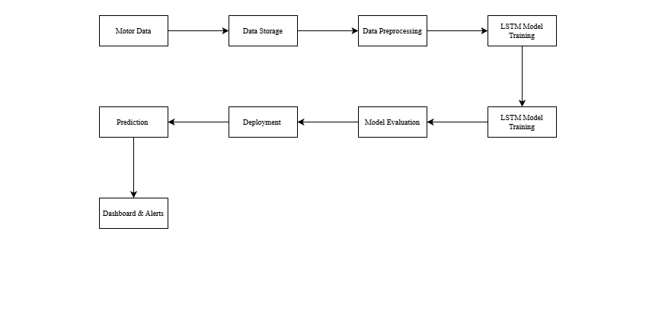
System Architecture

Slide 8
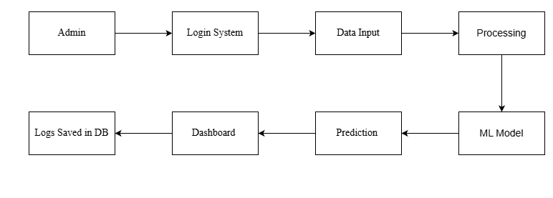
Workflow Of Project

Slide 9
Technology Stack
Programming Language
Python 3.9+
Backend Development
Flask (Web Framework)
Flask-CORS
dotenv (Environment variable management)
Machine Learning & Deep Learning
TensorFlow
KerasLSTM (Long Short-Term Memory Neural Network)
Scikit-learn
SMOTE (for class imbalance handling)
Data Processing & Analysis
Pandas
NumPy
Jupyter Notebook

Slide 10
Technology Stack
Cloud & Database
Supabase
Supabase PostgreSQL (Database)
Supabase Storage (Cloud Storage)
Supabase Auth (Authentication)
Frontend Development
HTML
CSS
Javascript
Visualization
Tableau Public
Version Control
Git
Development Tools
VS Code
Jupyter Notebook

Slide 11
Module Description
Data Generation Module
Collects and manages motor sensor data such as temperature, vibration, current, and load, either from cloud storage or simulated CSV datasets.
Data Processing Module
Cleans, normalizes, and prepares raw sensor data through preprocessing and feature engineering for accurate model training.
Prediction Module
Uses the trained LSTM machine learning model to analyze time-series data and predict equipment failure probability.
Dashboard Module
Displays real-time equipment status, prediction results, and historical trends through an interactive web-based interface.
Authentication Module
Handles secure user login, role-based access control, and logging of user activities using cloud-based authentication services.

Slide 12
Advantages
Reduces unexpected breakdowns by predicting potential failures in advance and enabling timely preventive maintenance actions.
Minimizes maintenance costs by shifting from reactive repairs to planned maintenance based on equipment condition.
Increases equipment lifespan through continuous monitoring and early detection of performance degradation.
Provides real-time monitoring of equipment health parameters for faster decision-making and operational control.
Ensures cloud scalability, allowing the system to handle increasing data volume and multiple equipment units efficiently.
Offers secure data storage with authentication and controlled access to protect sensitive operational information.
Improves overall operational efficiency by optimizing maintenance scheduling and reducing production downtime.

Slide 13
Limitations
Requires accurate historical data to train the machine learning model effectively and ensure reliable failure predictions.
Initial setup cost is high, as it involves cloud infrastructure configuration, system development, and model training.
Model accuracy depends on training data quality, and poor or imbalanced data can reduce prediction performance.
Requires stable internet connectivity for continuous cloud access, real-time monitoring, and data synchronization.
Needs periodic model retraining to adapt to new failure patterns, changing equipment behavior, and updated operational conditions.

Slide 14
Conclusions
The Proactive Equipment Care system presents an intelligent and scalable approach to predictive maintenance by integrating cloud computing, data analytics, and deep learning technologies. By continuously collecting and analyzing equipment data, the system enables early detection of potential failures and supports proactive maintenance planning. The implementation of an LSTM-based model enhances prediction accuracy, allowing industries to receive alerts 24–48 hours before possible breakdowns.
Overall, this project successfully demonstrates how cloud-integrated analytics can transform traditional reactive maintenance into a data-driven, predictive maintenance strategy. By reducing downtime, lowering maintenance costs, and improving equipment reliability, the system contributes to increased productivity, operational efficiency, and long-term industrial sustainability.

Slide 15
References
Dataset Reference: https://www.kaggle.com/datasets/stephanmatzka/predictive-maintenance-dataset-ai4i-2020
LSTM: https://www.geeksforgeeks.org/deep-learning/deep-learning-introduction-to-long-short-term-memory/
Keras: https://keras.io
Flask: https://flask.palletsprojects.com/en/stable/

Slide 16
Thank You

